Slide 1
PARENT COUNCIL
10/15/20

Slide 2
Agenda
Student Activities
Guidance
Music
Athletics
Teaching & Learning
Health & Safety Plan
Technology

Slide 3
Parent Council Norms
Be Respectful & Considerate – of other people’s thoughts and opinions
Be Responsible – ready to begin on time, be prepared, and maintain joy
Be Healthy – create a safe meeting environment where all feel comfortable enough to share their thoughts

Slide 4
Student Activities Update
NJHS Induction Dates & Certificates & Elections
  What is the plan for induction? Dr. Shillingford & Mrs. Schmitt doing a prerecorded presentation & administer certificates to students in Hybrid 1 & Hybrid 2 in 1st period week of 10/26. Will provide certificates to students online as an option to pick up in person.
  Will last year’s 9th grade students (current 10th grade) get a certificate? Yes!
  NJHS Officer Elections – Slides were due to Mrs. Schmitt Friday, 10/16 (she reached out to NJHS students).
  Is NJHS open to 7th grade? No…but this is when they “build” their resume for induction! It includes academic achievement as well as character education and community service!
Spirit Week
  October 26th- Holicong color wars (7th grade = white, 8th grade = yellow, 9th grade = green)
  October 27th- Pink Out- Breast Cancer Awareness (hybrid 1)
  October 28th- Pink Out- Breast Cancer Awareness (hybrid 2)
  October 30th- Sports day (wear something to represent your favorite team)

Slide 5
Student Activities Update
Will we have clubs?
  Yes! Clubs and extracurriculars are going to be available. We are looking to have a Student Activities Fair to introduce these and the challenge has been how to do this in a virtual format. As noted in meeting…our goal is the social-emotional wellness of students but the priority for the teaching staff was a focus on the virtual…and then hybrid learning model. You will see starting in the next few weeks more opportunities for students to engage.
  We do plan on sending out a survey to students (have ideas but want to hear from them) on ideas for time to engage with peers in a “social setting” outside the school day.

Slide 6
Music Updates
Select Music Groups are getting up and running
  String Ensemble has started. Robe Choir & Wind Ensemble auditions will begin soon.
  Students can audition for these groups regardless of hybrid/virtual mode. Rehearsals will be virtual for now.
Sequestered Songfests (Open-Mic Night Style Performances) will begin next week and will be held regularly throughout the year
Additional music-specific safety measures are in place in our classes
  Band students who play wind/brass instruments must have instrument specific PPE to play in class
  Band/choir classes are taking "air exchange" recommendations into account for playing/singing
We will use all of our creativity and resources to make this a memorable, wonderful, safe year in music.

Slide 7
Athletics Updates
Reviewed Schedule - https://holicongathletics.com/ - This is the HOMEBASE for Holicong athletics.
Reviewed Passes – Parents should have 2 passes per household. Thanks to Mrs. Loughlin for the idea to make these business cards. Please have these at games.
Health & Safety Plan – Thank you to everyone for following the guidelines for games (social distance, masks, etc.) We have had absolutely ZERO issues.
Cancellations – All Holicong & CB East sports cancellations will be announced at school over the PA & posted.
Winter Sports – Are we running winter sports? Earliest start date would be November 15th (Still TBD if/what winter sports are running)
  Family ID opens October 25th
  If you completed the Family ID paperwork for a fall sport – complete the required sections but the only documents needed uploading are section 7 or section 8 (TBD by individual student situation if injury in previous season)

Slide 8
Athletics Updates
Reviewed Schedule - https://holicongathletics.com/ - This is the HOMEBASE for Holicong athletics.
Reviewed Passes – Parents should have 2 passes per household. Thanks to Mrs. Loughlin for the idea to make these business cards. Please have these at games.
Health & Safety Plan – Thank you to everyone for following the guidelines for games (social distance, masks, etc.) We have had absolutely ZERO issues.
Cancellations – All Holicong & CB East sports cancellations will be announced at school over the PA & posted.
Winter Sports – Are we running winter sports? Earliest start date would be November 15th (Still TBD if/what winter sports are running)
  Family ID opens October 25th
  If you completed the Family ID paperwork for a fall sport – complete the required sections but the only documents needed uploading are section 7 or section 8 (TBD by individual student situation if injury in previous season)

Slide 9
Teaching & Learning – Feedback & Q and A
Based on conversation – will look to do another Canvas session for parents and added previous presentation/resources in chat – here they are:
https://www.cbsd.org/Page/44910
https://www.cbsd.org/Page/38118

Slide 10
Guidance Updates
New Student Group – This is for new students to CBSD.
General Student Groups – students can self-select. Forms being sent to students.
Success Plan and Naviance - https://www.cbsd.org/Page/289 . Success Plan documents and videos
Collecting Ideas for Further Socialization – Will send out survey. Shared virtual lunch idea.

Slide 11

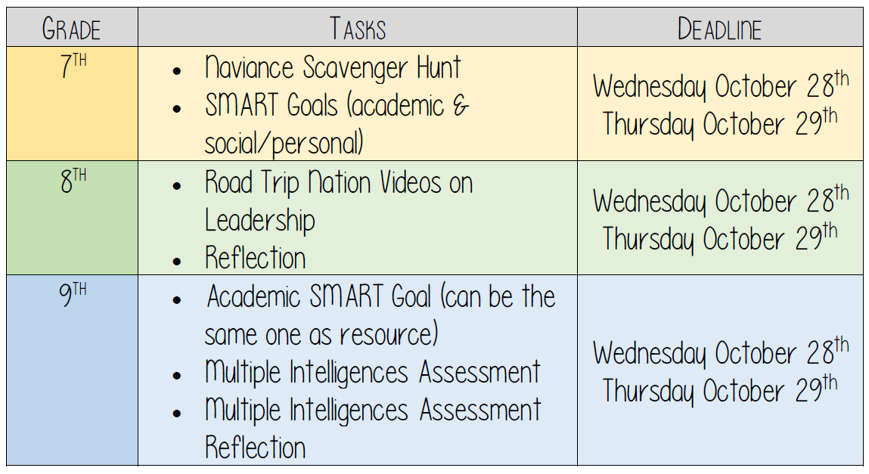
Success Plan
All resources are on the grade level canvas pages!

Slide 12
Health & Safety Plan
Attendance Procedures
  Cameras to Start Class – Expectation at beginning of class for attendance & smooth start to class (reminding students can take time and make process longer than needed).
  Excuse/Absence Notes – These need
Dismissal Procedures
  Staggered Dismissal
Car Riders – Pickup/Dropoff
  7:20 - If riders come after 7:20 – Mrs. D will be at music hallway until 7:28 – after that students need to report to front office (first period starts promptly at 7:30 and students need to be in class in person & online – students being tardy “physically/online” – this has an effect on entire class – has always been the case in traditional but now more transparent in current setting and asking for all students to be in class “in person or live on camera” at 7:30 and the beginning of each class. Since we cannot control this at school level in-person in traditional sense – asking for all parent and student support to follow expectation to ensure class time is maximized and teachers can focus the 44 minutes on teaching & learning.

Slide 13
Technology Updates
Kevin, Mike, Anthony, Greg, Karen, Melissa
Tech Office Hours
Laptop Procedures
ROCKET

Slide 14
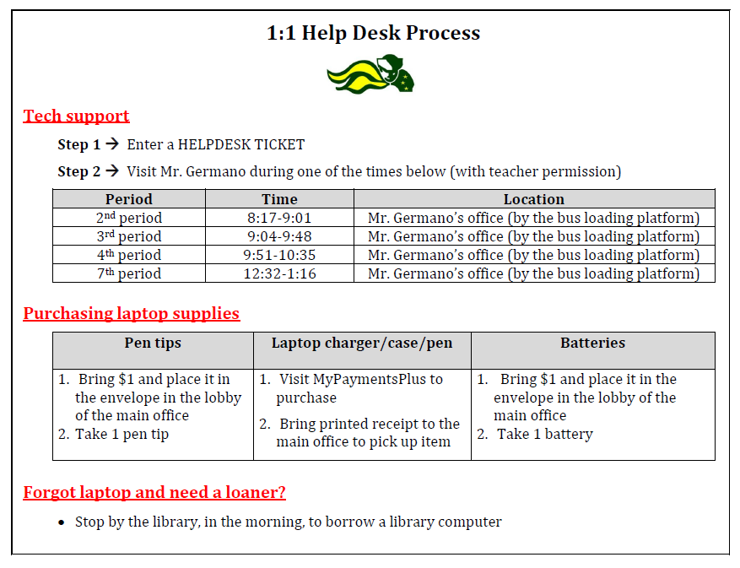
Help Desk
Students can go to help desk during resource or other available time with teacher permission.

Slide 15
Troubleshooting Computer Issues
Students follow the steps of ROCKET to troubleshoot technology issues.

Slide 16
Quick Hits
Fire Drill Location – teachers reviewed fire drill procedures and locations with students.
ALICE Training – will occur next week during resource.

Slide 17
Parent FAQ
Q/F: Having evening Parent Council sessions is greatly appreciated. Please send a notice with link on the day of the meeting.
A: We have done these every year I have been at Holicong…it is noted that attendance is often lower (sometimes only 1 or 2 parents) so when these are offered it is usually Mr. Canelli & Dr. Shillingford to respect the time of staff and guest presenters.
Q/F: How do I view my child's graded tests & quizzes in Canvas along with the mean/median of those items?
A: Grades are made available through Infinite Campus. Mean/median – don’t understand this question as it pertains to individual students.
Q/F: Please conduct a poll with parents 7th graders taking foreign language -- perhaps even a short course this Spring. The entire schedule has been altered for the Pandemic -- it should be possible to at least conduct a poll on the interest.
A: This is not something we would do at the school level as it pertains to the curriculum and scope & sequence at the district level. We recommend that you attend curriculum committee meetings and share feedback with that group. There meetings are scheduled and available to the public – here is the direct link to the Curriculum Committee Page on the CBSD website.

Slide 18
Parent FAQ
Q/F: Please open up Holicong facilities for CBAA Winter Basketball
A: This will be a discussion at the district level consistent across all schools with outside organizations as it pertains to the Health & Safety Plan.
Q/F: Is there more asynchronous learning with hybrid learning vs 100% virtual?
A: Don’t quite understand question but hopefully Teaching & Learning video helped with this question.
Q/F: Are teachers still teaching in the classroom 100% of the time?
A: Teachers (unless teleworking) are teaching/at Holicong Monday thru Friday.

Slide 19
Parent FAQ
Q/F: There should be a list of questions/suggestions submitted unless the matter pertains to a single individual.
A: Don’t quite understand the question. We have included a FAQ open to all parents, are open to questions during the meeting, and email and post our parent council meetings on our website…so do our best to provide as much information in as many mediums as possible.
Q/F: Principal Kevin Shillingford should conduct an on the record Q&A that is summarized accurately and be publicly accessible to all parents. We need better transparency & accountability and should be treated like adults.
A: We do our best to provide as many outlets for parents to do Q & A in advance and in our meetings while trying to be respectful of the many different topics, presenters, and individual questions. We provide daily announcements, weekly updates, video updates, and have links on our sites with much of our information that often comes up and do our best to make this readily accessible. We always look for feedback from parents on how to best communicate and always look for ways to improve – the results of our most recent survey showed that some parents thought we “overcommunicate” while others thought the communications is excellent. Based on the feedback we have received at our Parent Council meetings – we will continue to send the information for those that want it so you “have it if you need it” – which is better than not having it.

Slide 20
Parent FAQ
Q/F: What are the policies regarding video/online demos as a percentage of teaching in class? There should be specific guidelines on the science & math classes that describe the time spent on teach lectures & time spent on problem solving. Council Rock parents had an incident where too much time was spent showing videos in Science.
A: There are no specific policies on this (in this question it only includes science & math so don’t know if there is a specific question/issue). Our teachers are utilizing the best practices they can as they navigate this hybrid teaching model and trying to teach students “in class and online” – we have spent much time in our professional development plan to allow teachers to navigate this process and they are doing a great job. It is hard to express in words how “different/hard” it is to change your entire way of doing your work when you are used to having 20-25 students in a classroom to having some online and some in class…it is a challenge but our teachers are doing a great job and trying to engage all students in the learning process…and asking our parents/students to support them as we navigate this together.

Slide 21
PARENT COUNCIL
10/15/20

